Slide 1
Object-Oriented Programming (OOP)
Week – 07
Mar 16-20, 2020
Instructor: Basit Ali
Email: basit.jasani@nu.edu.pk
Object-Oriented Programming (OOP)

Slide 2
Recap – Inheritance
Derived class inherits all the characteristics of the base class
Besides inherited characteristics, derived class may have its own unique characteristics
Major benefit of inheritance is reuse

Slide 3
Generalization
In OO models, some classes may have common characteristics
We extract these features into a new class and inherit original classes from this new class
This concept is known as Generalization

Slide 4
Example – Generalization
Line
Circle
Triangle
color
vertices
length
color
vertices
radius
color
vertices
angle
move
setColor
getLength
move
setColor
computeArea
move
setColor
computeArea

Slide 5
Shape
color
vertices
move
setColor
Triangle
Circle
radius
Line
angle
computeArea
length
computeArea
getLength

Slide 6
Overriding
A class may need to override the default behavior provided by its base class
Reasons for overriding
Provide behavior specific to a derived class
Extend the default behavior
Restrict the default behavior
Improve performance

Slide 7
Example – Specific Behavior
color
vertices
draw
move
setColor
Triangle
Circle
radius
Line
angle
draw
computeArea
length
draw
computeArea
draw

Slide 8
Example – Improve Performance
Shape
color
coord
Class Circle overrides rotate operation of class Shape with a Null operation.
draw
rotate
setColor
Circle
radius
draw
rotate

Slide 9
Polymorphism
The process of representing one Form in multiple forms is known as Polymorphism
Polymorphism is derived from 2 Greek words: poly and morphs. The word "poly" means many and morphs means forms. So polymorphism means many forms.

Slide 10
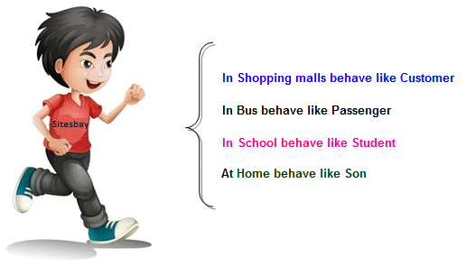
Real life example of Polymorphism
Suppose if you are in class room that time you behave like a student, when you are in market at that time you behave like a customer, when you at your home at that time you behave like a son or daughter, Here one person have different-different behaviors.

Slide 11
Type of Polymorphism
Static / Compile time polymorphism
Dynamic / Run time polymorphism

Slide 12
Static / Compile time polymorphism
It is also called Early Binding
It happens where more than one methods share the same name with different parameters or signature and different return type.
It is known as Early Binding because the compiler is aware of the functions with same name and also which overloaded function is to be called is known at compile time.

Slide 13
Static / Compile time polymorphism
Overloading
Function Overloading (ALREADY DISCUSSED)
Constructor Overloading (ALREADY DISCUSSED)
Operator Overloading (TO BE DISCUSSED)

Slide 14
Dynamic / Run time polymorphism
This refers to the entity which changes its form depending on circumstances at runtime. This concept can be adopted as analogous to a chameleon changing its color at the sight of an approaching object.
Method Overriding uses runtime Polymorphism.
It is also called Late Binding.

Slide 15
Dynamic / Run time polymorphism
Runtime Polymorphism is done using virtual and inheritance.
When overriding a method, the behavior of the method is changed for the derived class.

Slide 16
Function/Method Overloading
Whenever same method name is exiting multiple times in the same class with different number of parameter or different order of parameters or different types of parameters is known as method overloading

Slide 17
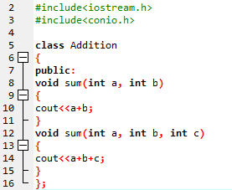
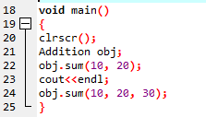
Example
Output:
30
60

Slide 18
Function/Method Overriding
Define any method in both base class and derived class with same name, same parameters or signature, this concept is known as method overriding

Slide 19
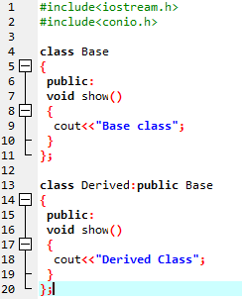
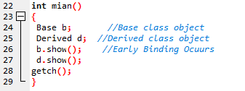
Example
Output:
Base class
Derived class

Slide 20
Exercise
Consider the following scenario:
There is a motor repair shop which has different mechanics working in it. The mechanics are paid salary and their names and experience is considered. The shop is reliable and has a lot of customers. Each mechanic can repair or paint a car and generate bill accordingly. The customers have to pay Rs.5000 for repair and Rs10,000 for paint. Furthermore, some of the customer are valued customers, for these customers the mechanic charges only Rs.3000 for repair and Rs.7500 for paint. A mechanic is paid 5% of this charged amount as daily wages (apart from monthly salary).

Slide 21
Hybrid Inheritance: Potential problem
common dangerous pattern: "The Diamond"
Classes B and C extend A
Class D extends A and B
Class D extends A and C
A
B
C
D

Slide 22
Problems with Hybrid Inheritance
Increased complexity
Reduced understanding
Duplicate features

Slide 23
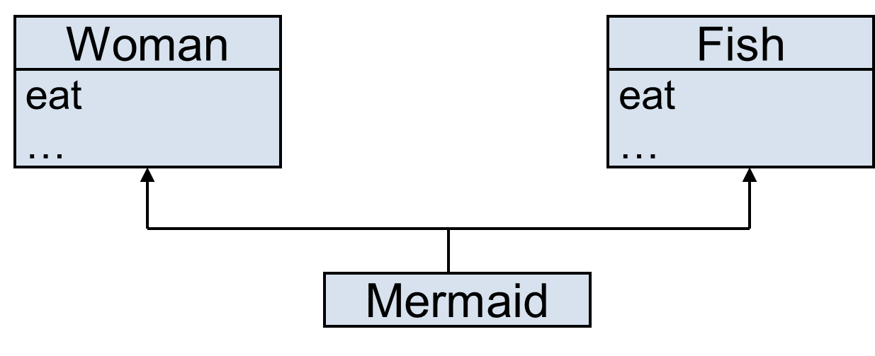
Problem – Duplicate Features
Which eat operation Mermaid inherits?

Slide 24
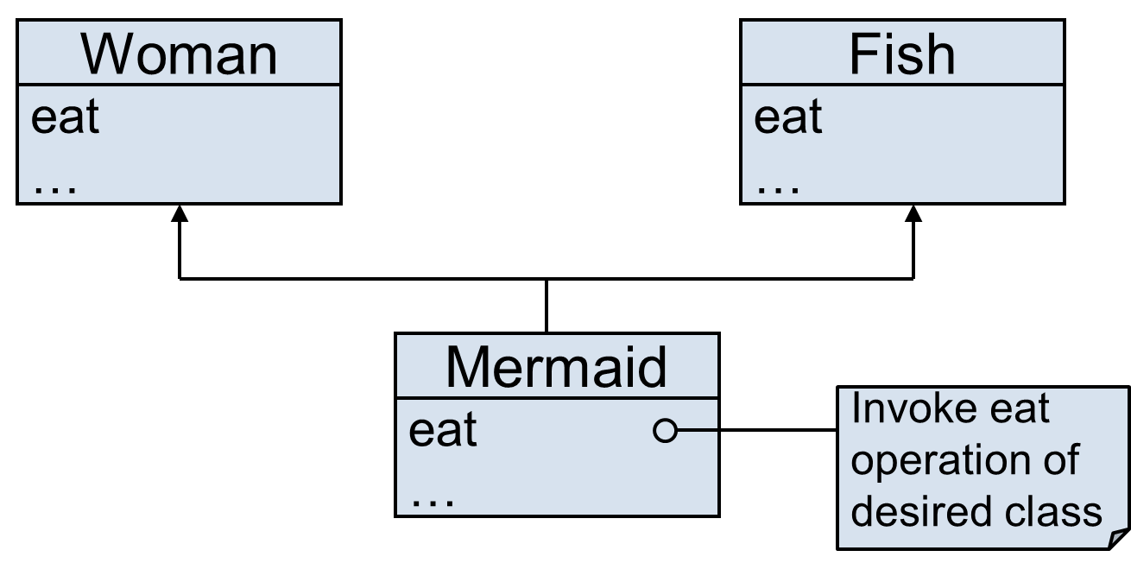
Solution – Override the Common Feature

Slide 25
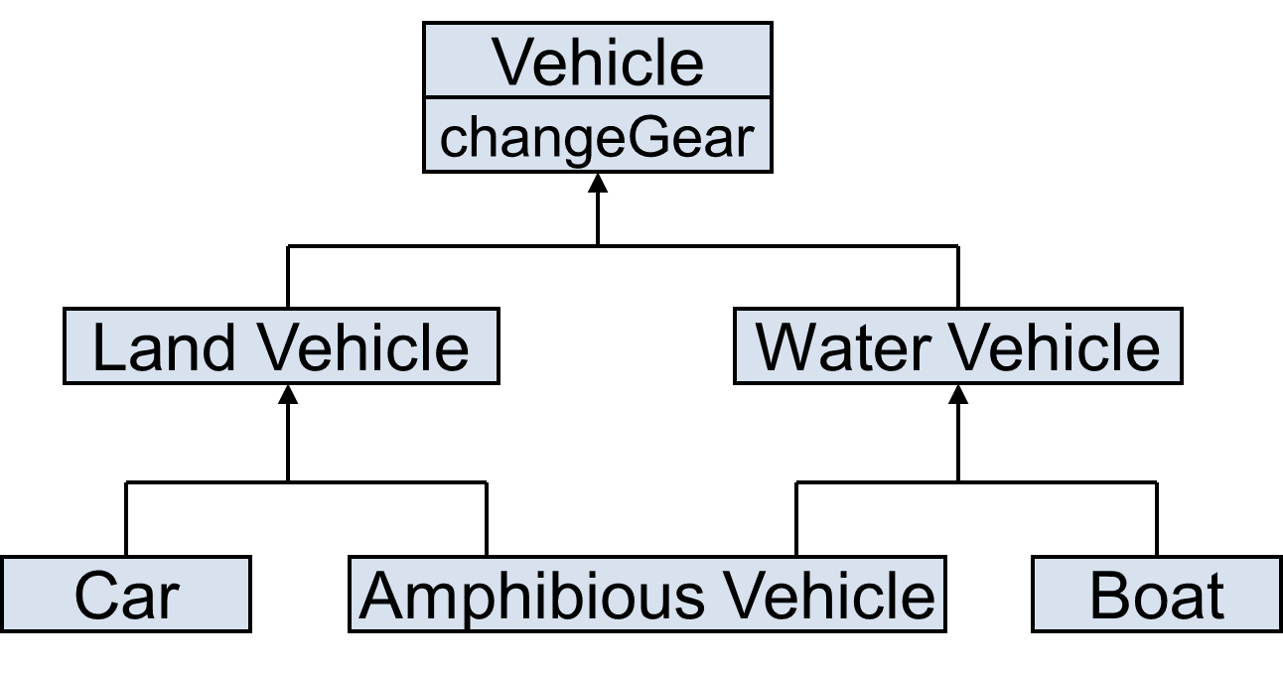
Problem – Duplicate Features (Diamond Problem)
Which changeGear operation Amphibious Vehicle inherits?

Slide 26
Solution to Diamond Problem
Some languages disallow diamond hierarchy
Others provide mechanism to ignore characteristics from one side

Slide 27


Solution to Diamond Problem (Virtual Inheritance)
What happens without virtual inheritance:
You want: (Achievable with virtual inheritance)

Slide 28
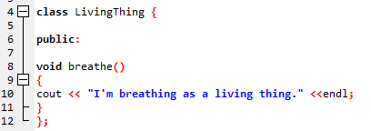
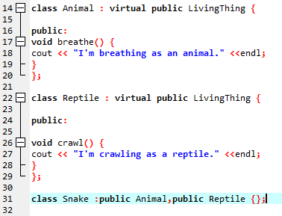
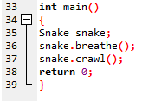
Solution..

Slide 29
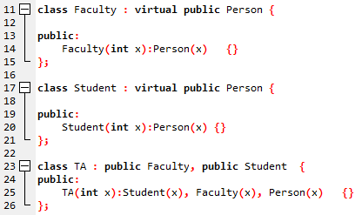


Diamond Problem Solution (With constructor)

